Slide 1
One Pixel Attack for Fooling Deep Neural Network
Jiawei Su*, Danilo Vasconcellos Vargas* and Kouichi Sakurai
IEEE Transactions on Evolutionary Computation,2019

Slide 2
Content
Problem description
One pixel attack Concept
What is DE (Differential Evolution)
Methodology
Re-Implementation and Result
Enhancement
Conclusion
References
Q/A

Slide 3
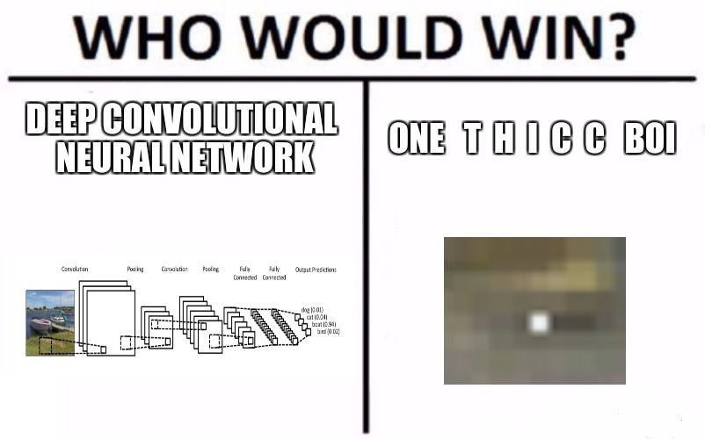
Problem Description
Source: https://www.researchgate.net/figure/One-pixel-attacks-created-with-the-proposed-algorithm-that-success

Slide 4
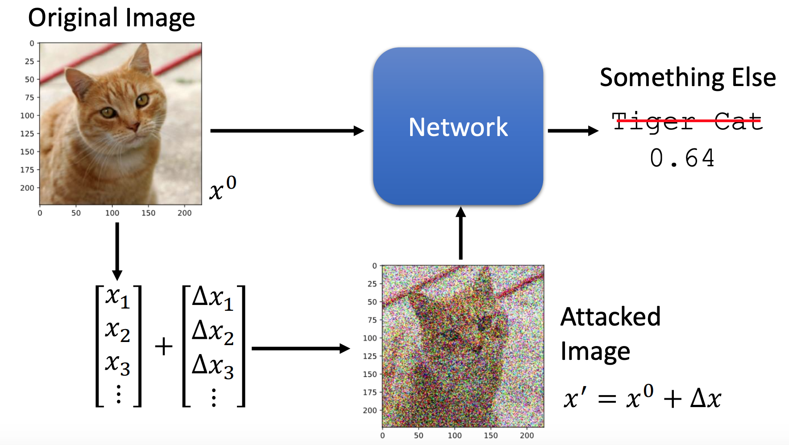
What is Adversarial Attack ?
Designing an input image in a specific way to get the wrong result form the model.
Source: https://pablormier.github.io/2017/09/05/a-tutorial-on-differential-evolution-with-python

Slide 5
Targeted Attack and Untargeted Attack
Targeted:
When an image cause a model to classify an image as a given target class.
Perturb an image as to maximize the probability of a class of our own choice.
Untargeted :
It cause a model to misclassify an image with no target.
perturb an image as to minimize the confidence probability of the correct classification category.

Slide 6
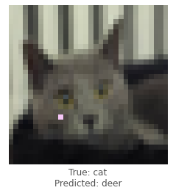
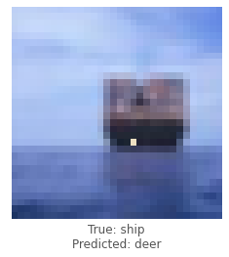
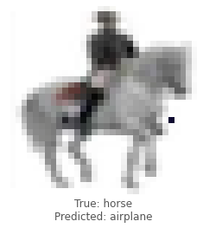
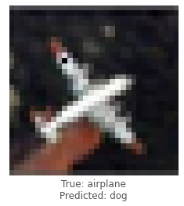
How many Pixel required to misclassify Neural network ?
Just one pixel.. You heard it right..
Images are rep in form of vector and changing
the right pixel can affect the accuracy of the
ML Model.
It works on adding small Adversarial Perturbation
to input vector.
what is Adversarial Perturbation?
Adversarial Perturbation can be added by DE.
( Then what is DE....!!!!)

Slide 7
D.E.(Differential Evolution)
It is an evolutionary Computation method.
It is a population-based optimization algorithm for solving complex multi-modal optimization Problems.
It is a global optimization of nonlinear and non- differentiable continuous space functions.
It starts with an initial population of candidate solutions

Slide 8
D.E.(Differential Evolution)
The Ackley function is widely used for testing optimization algorithms.
In its two-dimensional form, as shown in the plot below.
Source: https://pablormier.github.io/2017/09/05/a-tutorial-on-differential-evolution-with-python

Slide 9
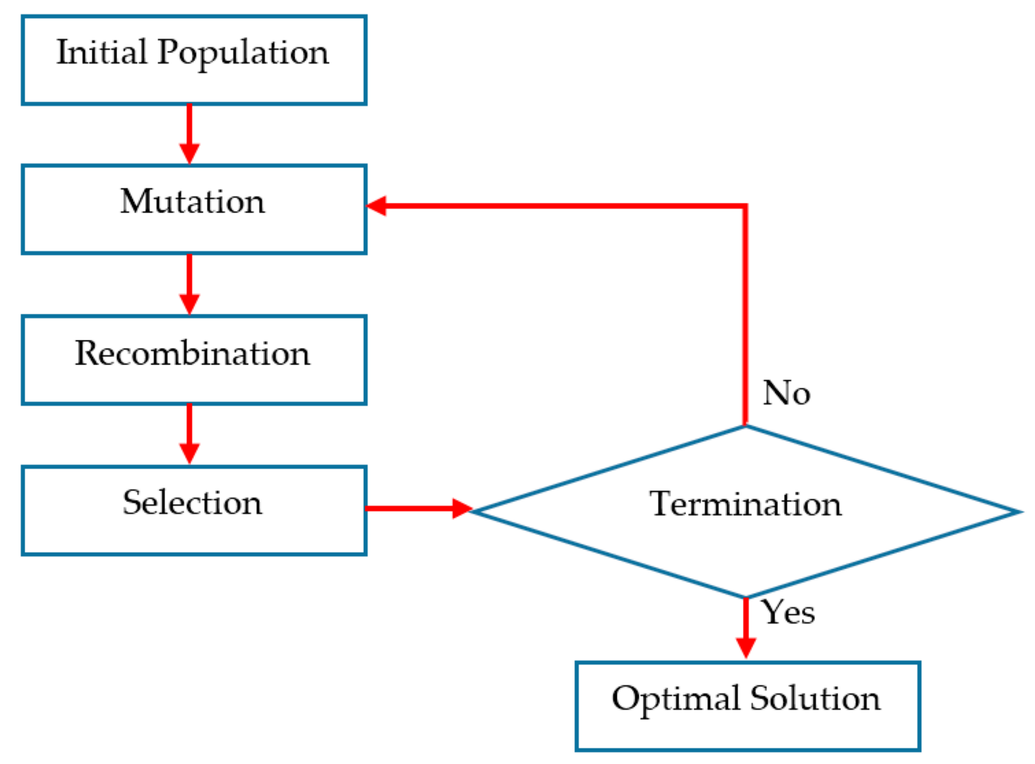

Slide 10
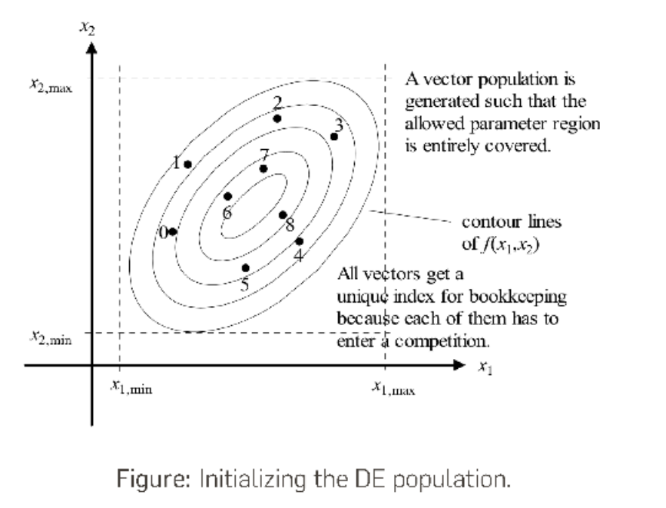
Differential Evolution
Source: Introduction to the Differential Evolution Algo. ~ Merlin Keller – Jerome stenger

Slide 11
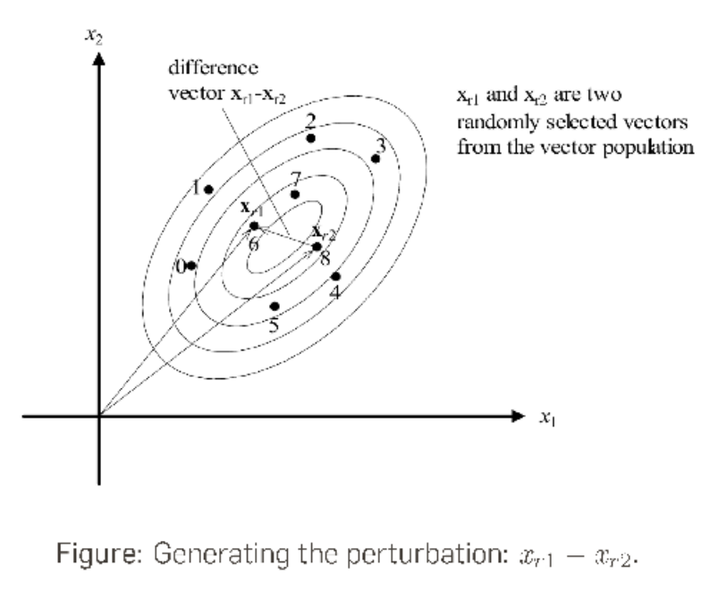
Differential Evolution
Source: Introduction to the Differential Evolution Algo. ~ Merlin Keller – Jerome stenger

Slide 12
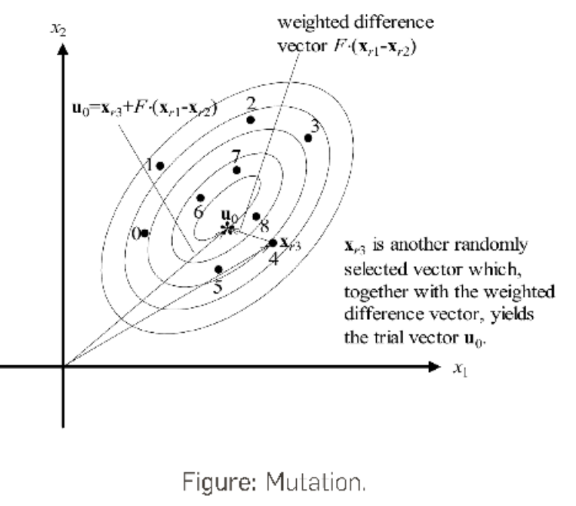
Differential Evolution
Source: Introduction to the Differential Evolution Algo. ~ Merlin Keller – Jerome stenger

Slide 13
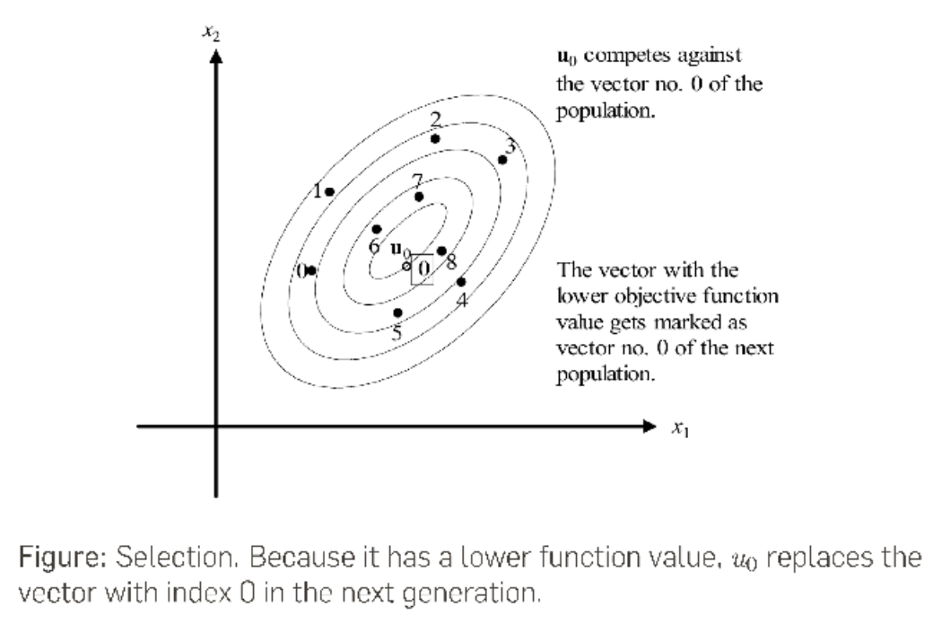
Differential Evolution
Source: Introduction to the Differential Evolution Algo. ~ Merlin Keller – Jerome stenger

Slide 14
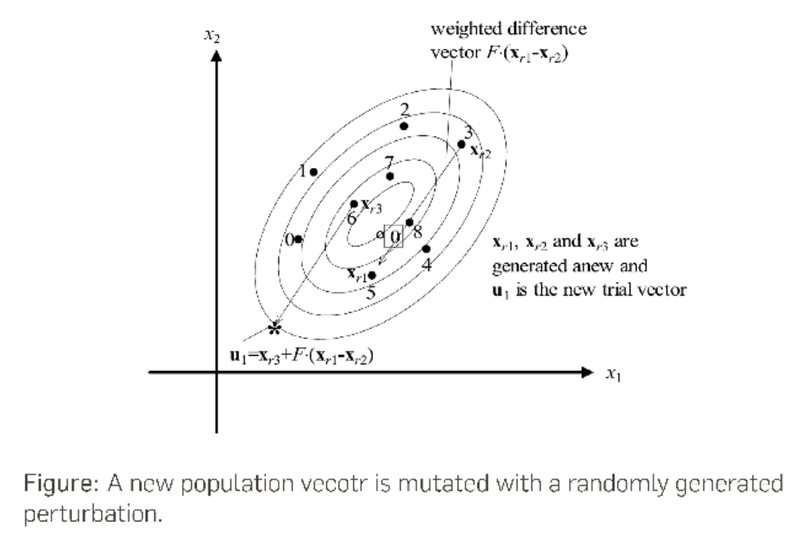
Differential Evolution
Source: Introduction to the Differential Evolution Algo. ~ Merlin Keller – Jerome stenger

Slide 15
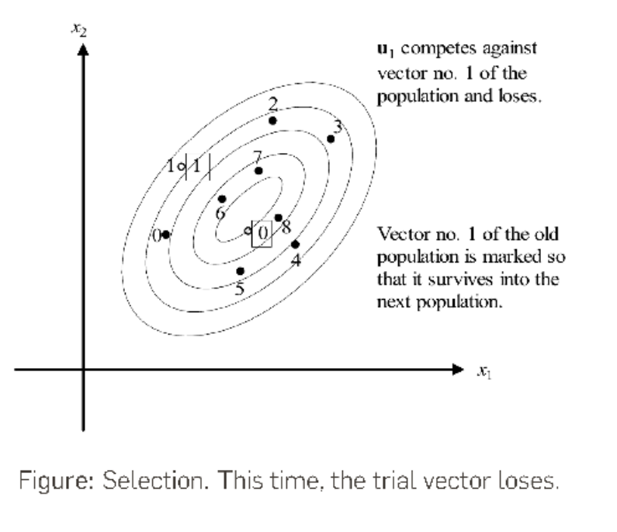
Differential Evolution
Source: Introduction to the Differential Evolution Algo. ~ Merlin Keller – Jerome stenger

Slide 16
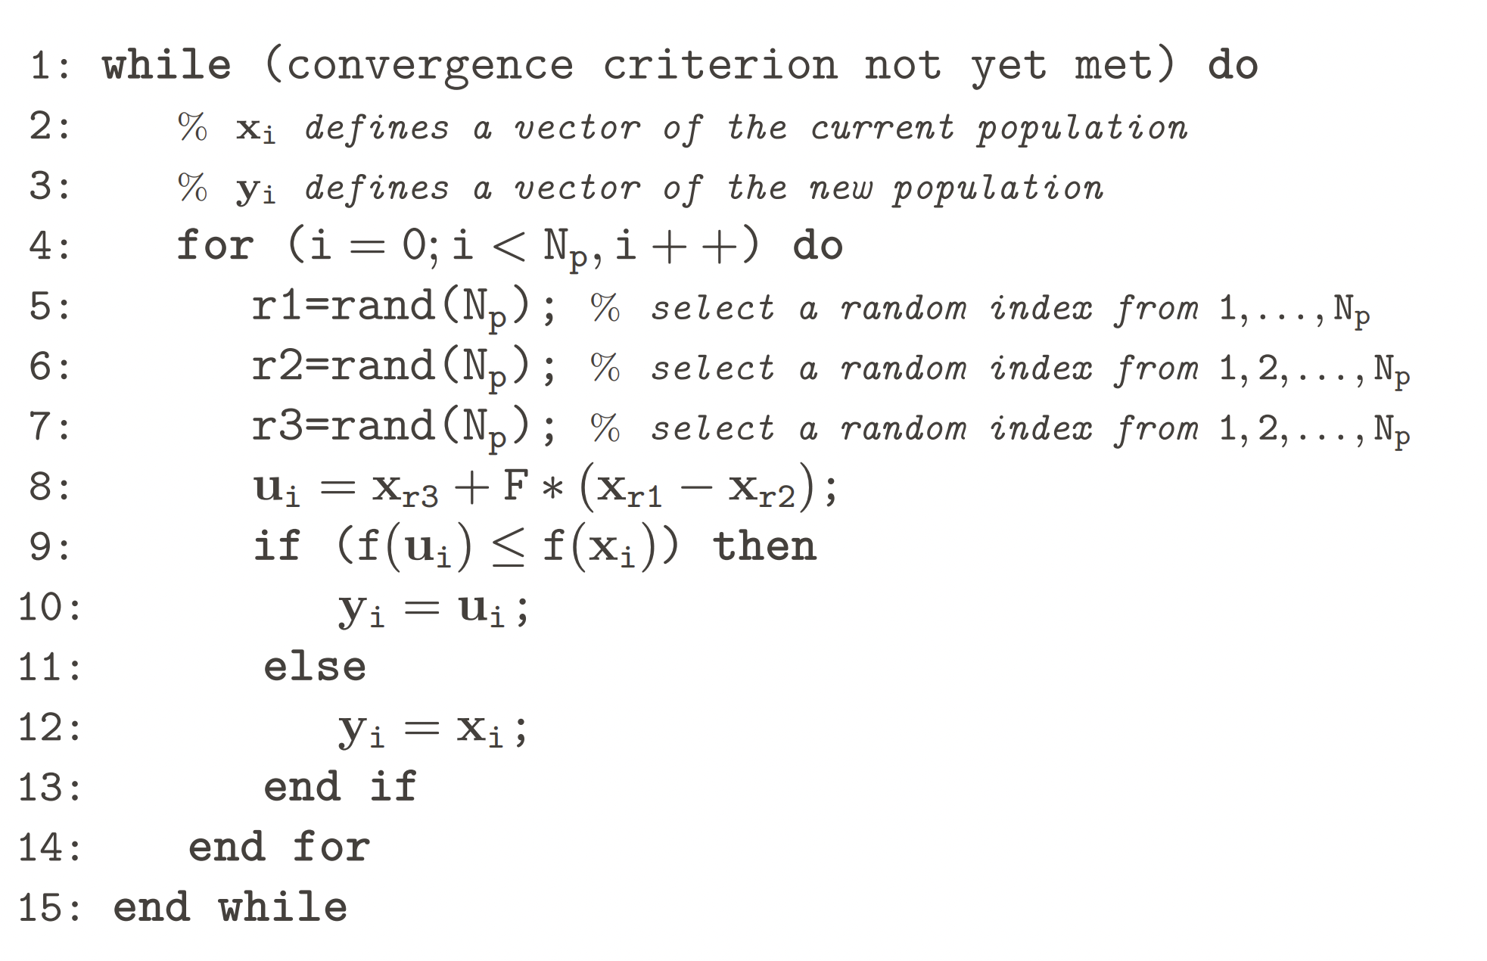
Pseudo code

Slide 17
DE Generation

Slide 18
Advantages of using DE
Higher probability of finding Global Optima: DE is less prone to being stuck in the local minima compared to Gradient Descent Algorithm.
Require less information from target System: DE does not need the optimization problem to be differentiable. So it can be used with many problems.
Simplicity : It is independent of the classifier that is being used.

Slide 19
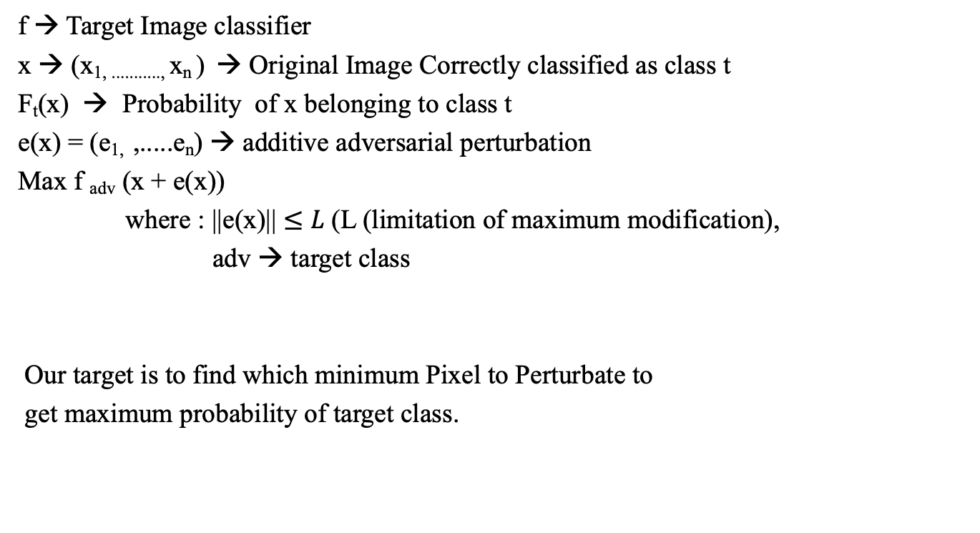
Methodology
f → Target Image classifier
x → (x_{1, ...........,} x_{n} ) → Original Image Correctly classified as class t
F_{t}(x) → Probability of x belonging to class t
e(x) = (e_{1,} ,.....e_{n}) → additive adversarial perturbation
Max f _{adv} (x + e(x))
where : ||e(x)|| $≤L$(L (limitation of maximum modification),
adv → target class
Our target is to find which minimum Pixel to Perturbate to
get maximum probability of target class.
43 | 56 | 65 | 13
59 | 66 | 0 | 35
12 | 89 | 99 | 45
59 | 60 | 45 | 90

Slide 20
Implementation
Dataset 1: Kaggle Cifar-10 test Dataset
500 (32*32) images chosen randomly.
Trained on:- All Convolutional network (AllConv),Network in Network(NiN) and VGG16
Targeted attacks on 9 classes.
Also, Implements 3 and 5 Pixel attacks.
Dataset 2: ISLVRC 2012 Test dataset
105 images and resized to 227x227
Trained on BVLC AlexNet
Non-targeted attacks
Contains 1000 classes.

Slide 21
Evaluation Metrics
Success Rate: percentage of adversarial images that were successfully classified by the target system as an arbitrary target class.
Adversarial Probability Labels (Confidence): For each successful perturbation, add up the values of the target class's probability label, then divide by the total number of successful perturbations.
Number of Target Classes: number of natural images that successfully perturb to a certain number of target classes.

Slide 22
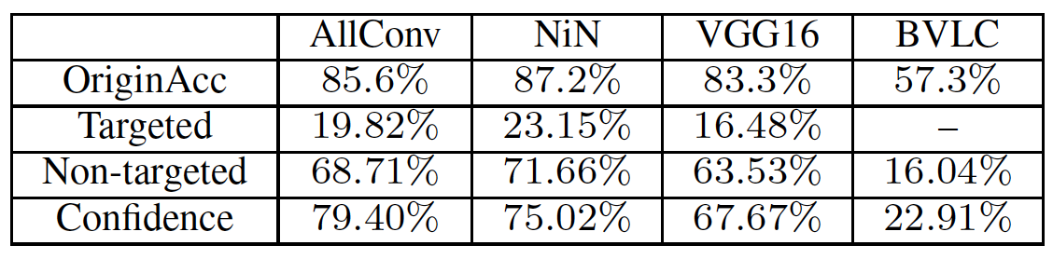
Results
Results of conducting one-pixel attack on four different types of networks: all convolutional network (allconv), Network in Network (nin), VGG16 and Bvlc on cifar10 dataset.
The original accuracy is the accuracy on the natural test datasets.
Targeted/non-targeted indicate the accuracy of conducting.
Confidence is the average probability of target classes.
On ImageNet dataset it shows due to large pixel size its difficult to misclassify the image but we can see the accuracy of model decreases after we perturbed the image.

Slide 23
Enhancement
For enhancement, I used two trained models on the cifar10 dataset, resnet and lenet, which provide attack accuracy of 38% and 45%, respectively.

Slide 24
Conclusion
If the number of iterations or initial candidate solutions were increased, the results might improve.
It is faster compared to existing methods since it does now have preprocessing steps.
Even though this method might be less accurate compared to existing methods, it would be a better choice for real time detection system.

Slide 25
References
https://www.cs.toronto.edu/~kriz/cifar.html
https://arxiv.org/abs/1710.08864
https://github.com/BIGBALLON/cifar-10-cnn
https://github.com/Hyperparticle/one-pixel-attack-keras
https://medium.datadriveninvestor.com/what-should-we-learn-from-the-one-pixel-attack-a67c9a33e2a4
https://www.researchgate.net/figure/One-pixel-attacks-on-ImageNet-dataset-where-the-modified-pixels-are-highlighted-with-red_fig4_320609325

Slide 26
Thank YOU
Rudraksh Sugandhi

Slide 27
Q/A

